Slide 1
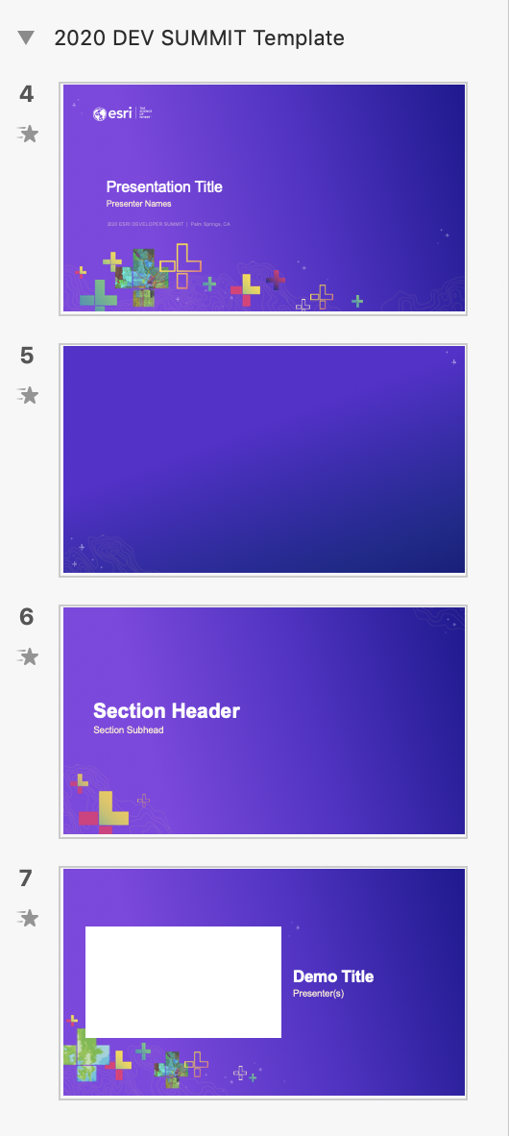
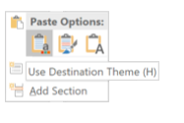
How to apply this template to existing slides
Which background to use?
Open your previous presentation.
Copy all relevant slides from previous presentation to this template. Paste using Destination Theme.
Going slide by slide, copy the Standard Background image.
Paste and send to back. Windows shortcut: Ctrl+Shift+[
Delete any remaining pieces left from the old background.
For other backgrounds (Title, Section Divider, Demo Intro) use the provided slides in this template.
Check your fonts. The default font is Arial to maintain consistency across the enterprise. If you used Avenir previously, consider switching to Arial to avoid unknown font substitution by other users. Instructions for changing font themes.
Why not use PowerPoint’s template features?
Title
Standard Background
Section Divider
Demo Intro
—
Use behind Images
Notes:
G456808 DEVELOPER SUMMIT 2020 Template for Esri staff

Slide 2

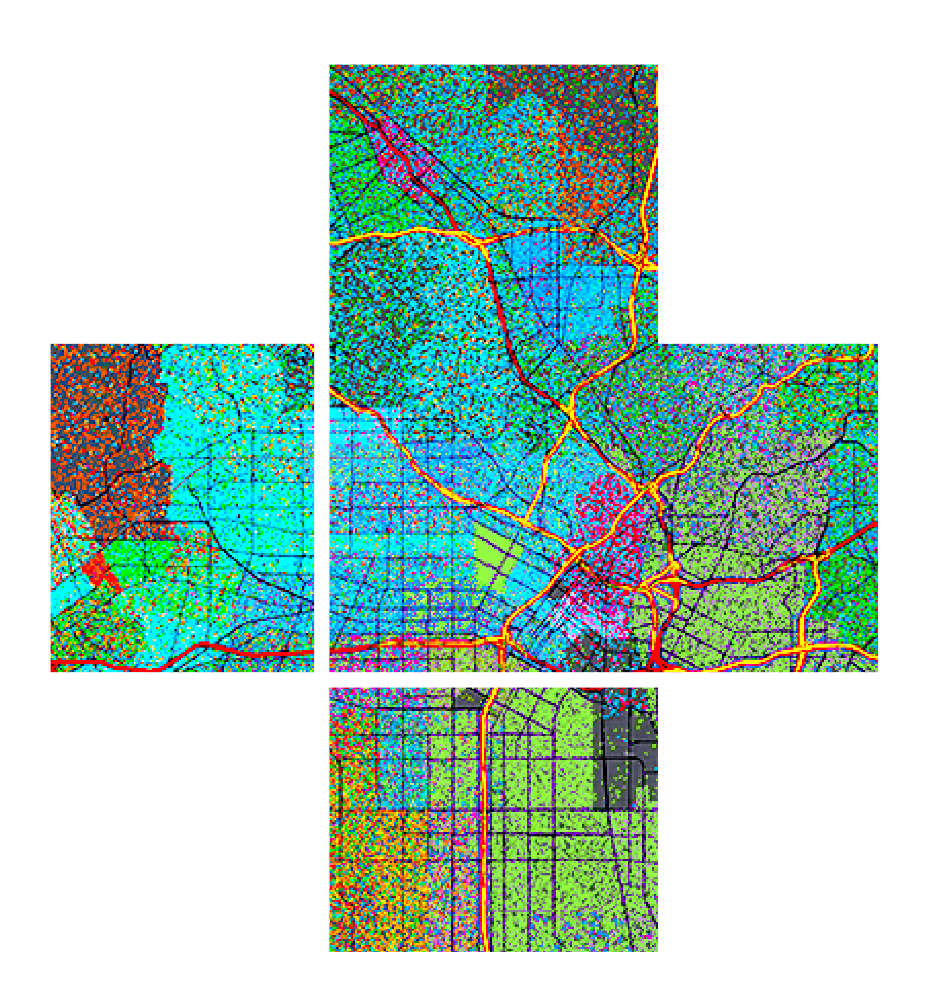








ArcGIS API for JavaScript: Creating Custom Layers and Layer Views
Please leave artwork “+” clustered.
Do not use them alone, as bullet points, or as a “plus” concept. Thank you.
Jacob Wasilkowski @JWasilGeo
2020 ESRI DEVELOPER SUMMIT | Palm Springs, CA

Slide 3


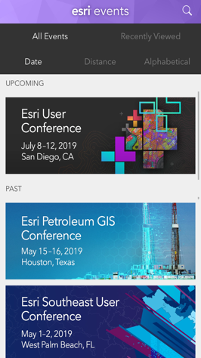
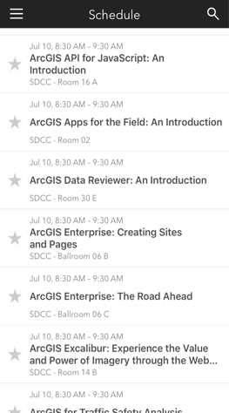
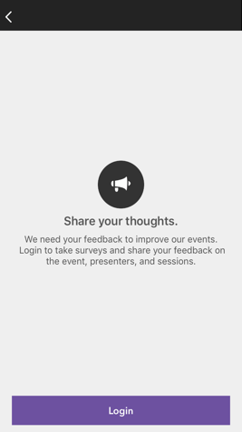
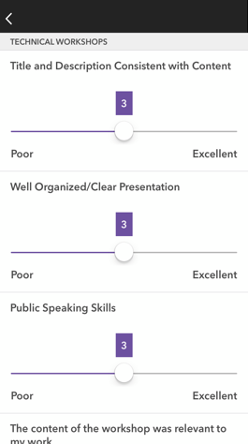




Please Share Your Feedback in the App
Download the Esri Events app and find your event
Select the session you attended
Scroll down to “Survey”
Log in to access the survey
Complete the survey and select “Submit”
Notes:
Guidance:
This is the survey slide. You can use the example as is or you can screenshot your session.

Slide 4



Slide 5


Section Header
Section Subhead

Slide 6

Demo Title
Presenter(s)

Slide 7
ArcGIS API for JavaScript: Creating Custom Layers and Layer Views
Please leave artwork “+” clustered.
Do not use them alone, as bullet points, or as a “plus” concept. Thank you.
Jacob Wasilkowski @JWasilGeo
2020 ESRI DEVELOPER SUMMIT | Palm Springs, CA

Slide 8



Agenda
Intro to custom Layers and LayerViews in JSAPI 4.x
Examples and demos
Deep dive into a custom visualization for a 2D MapView

Slide 9
Finding Our Way
Where to begin making custom Layers and Layer Views

Slide 10
Extending JSAPI 4.x with a custom “Layer”
Custom Layer 2D MapView & 3D SceneView
BaseDynamicLayer esri/layers/ BaseDynamicLayer
BaseElevationLayer esri/layers/ BaseElevationLayer
BaseTileLayer esri/layers/ BaseTileLayer

Slide 11
Extending JSAPI 4.x with a custom “Layer”
Layers are for data access; they do not have direct visual representation
Why create a custom layer?
To connect to a service not supported (yet) by the JSAPI
To manipulate data client-side before it is displayed in a 2D MapView or 3D SceneView
To mash up multiple services to create new visualizations
Limitations
Suited for static content
No control over when it redraws
Limited to image formats and tiles

Slide 12
Extending JSAPI 4.x with a custom “LayerView”
Custom LayerView 2D MapView only
BaseLayerView2D esri/views/2d/layers/ BaseLayerView2D
BaseLayerViewGL2D esri/views/2d/layers/ BaseLayerViewGL2D

Slide 13
Extending JSAPI 4.x with a custom “LayerView”
2D MapView only
Represents the view of a Layer after it has been added to a Map
Responsible for calling a Layer’s API to get data and redraw
Canvas API or WebGL API is exposed to draw anything you want in a 2D MapView

Slide 14
Extending JSAPI 4.x with custom “externalRenderers”
Custom externalRenderers 3D SceneView only
externalRenderers esri/views/3d/ externalRenderers

Slide 15
Extending JSAPI 4.x with custom “externalRenderers”
3D SceneView only
WebGL API is exposed to draw anything you want in a 3D SceneView

Slide 16
Demos & Code
Enough words, more pictures

Slide 17
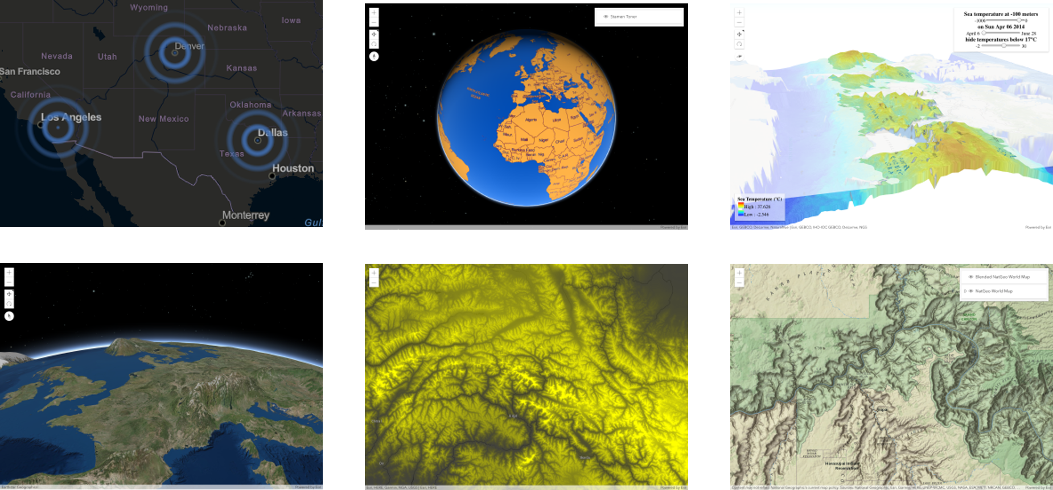
Examples of what’s possible: https://esriurl.com/jsCustomLayers

Slide 18
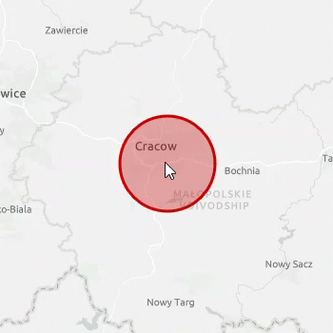
Demo
A deep dive into making a custom and animated BaseLayerView2D
Review a simple GraphicsLayer
Create a static BaseLayerView2D
Animate it!
https://github.com/jwasilgeo/esri-experiments

Slide 19
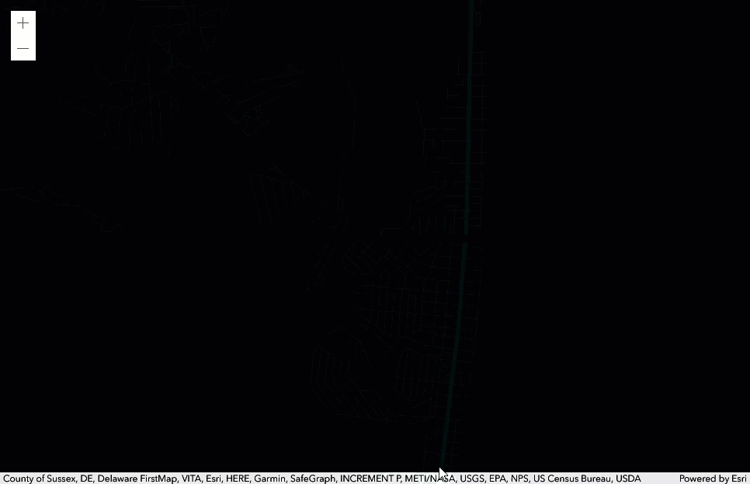
Demo
A custom BaseLayerView2D made by Sean McGee
https://codepen.io/smcgee/pen/KKpKPxW
@HertsWestUK

Slide 20
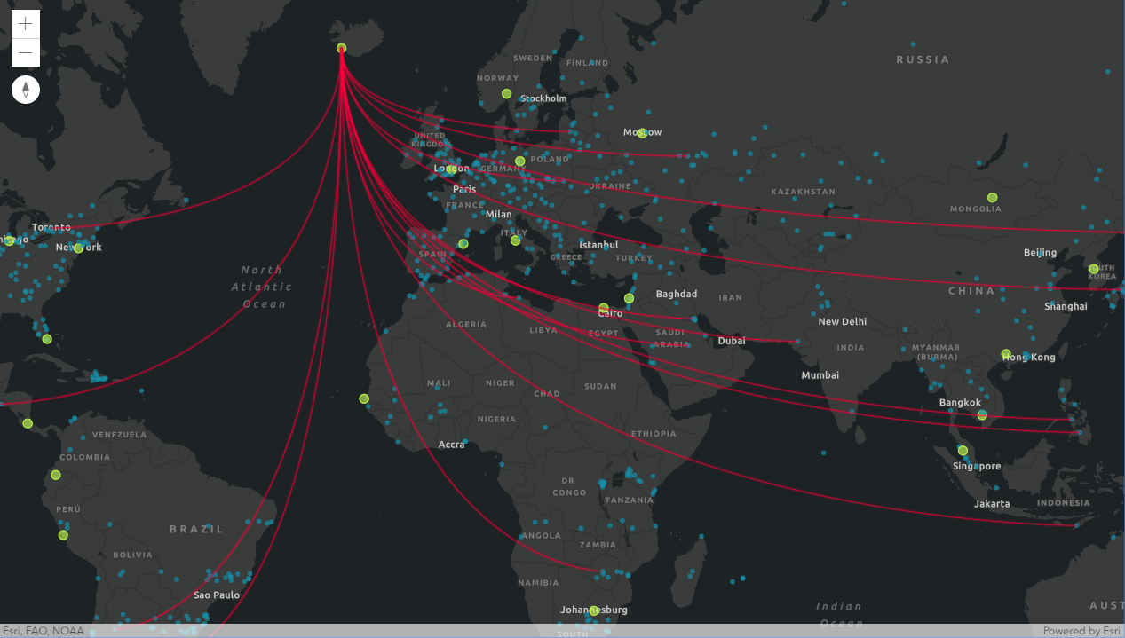
Demo
“Canvas-Flowmap-Layer”
A custom BaseLayerView2D made in collaboration with Sarah Bell
@sarahbellmaps
https://github.com/sarahbellum/Canvas-Flowmap-Layer

Slide 21
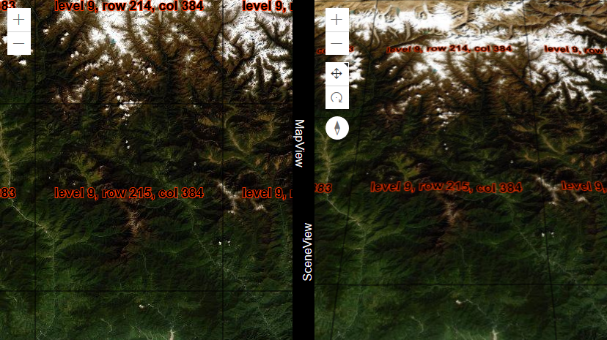
Demo
Making a custom
BaseTileLayer
https://github.com/jwasilgeo/esri-experiments

Slide 22

Demo
“Earth at Night, Mountains of Light”
Built with a custom BaseElevationLayer
https://jwasilgeo.github.io/esri-experiments/earth-at-night/

Slide 23
Resources
These slides will be available at
Esri Proceedings webpage
https://github.com/jwasilgeo/presentations
Blog post about “Earth at Night, Mountains of Light”
https://petrichor.studio/2019/02/14/earth-at-night-mountains-of-light/
Dev Summit 2019: “ArcGIS API for JavaScript: Creating Custom Layers and Layer Views”
https://proceedings.esri.com/library/userconf/devsummit19/papers/DevSummitPS_10.pdf
Dev Summit 2018: “ArcGIS API for JavaScript: Creating Custom Layers”
https://proceedings.esri.com/library/userconf/devsummit18/papers/dev-int-018.pdf

Slide 24
Related Presentations at Dev Summit 2020
ArcGIS API for JavaScript: Building Custom Visualizations Using WebGL in 2D Map Views
Tuesday, March 10 at 4:00pm (Primrose C-D)
Dario D’Amico, Yaron Fine
ArcGIS API for JavaScript: A Look Under the Hood
Thursday, March 12 at 9:00am (Pasadena/Sierra/Ventura)
Yann Cabon, Yaron Fine
ArcGIS API for JavaScript: Building custom visualizations using WebGL in 3D Scene Views
Thursday, March 12 at 1:00pm (Demo Theater 1: Oasis 1-2)
David Koerner, Jesse van den Kieboom
ArcGIS API for JavaScript: Working with Animation Libraries
Thursday, March 12 at 1:45pm (Demo Theater 1: Oasis 1-2)
Arno Fiva, Raluca Nicola

Slide 25
Thank you!
Please leave artwork “+” clustered.
Do not use them alone, as bullet points, or as a “plus” concept. Thank you.
Jacob Wasilkowski @JWasilGeo
2020 ESRI DEVELOPER SUMMIT | Palm Springs, CA

Slide 26
Please Share Your Feedback in the App
Download the Esri Events app and find your event
Select the session you attended
Scroll down to “Survey”
Log in to access the survey
Complete the survey and select “Submit”
Notes:
Guidance:
This is the survey slide. You can use the example as is or you can screenshot your session.

